Slide 1
Finance and Innovation
Mary O’ Sullivan
In The Oxford Handbook of Innovation
edited by Jan Fagerberg, David C. Mowery, and Richard R. Nelson. Oxford University Press.
Summary by Moonyul Yang

Slide 2
Table of Contents
Introduction
The Role of Finance in the Economics of Innovation
The Pioneering Work of Schumpeter
The Neglect of Finance in the Contemporary Economics of Innovation
Innovation and the Economics of Finance
The Microeconomics of Enterprise Finance
Financial Systems and Economic Growth
A New Agenda for Research on Finance and Innovation
Finance Theory and the Dynamics of Economic Change
The Possibilities and Problems of Integration between Fields
Conclusion
Discussion

Slide 3

The Author Introduction
Mary O'Sullivan has been Professor of Economic History at the University of Geneva since August 2010.
Her research focuses on the history of capital, industries and enterprises, and the comparative history of economic development.
Her book, Dividends of Development: Securities Markets in the History of US Capitalism, 1866-1922 , was published by Oxford University Press in 2016.
* Source : theconversation.com

Slide 4
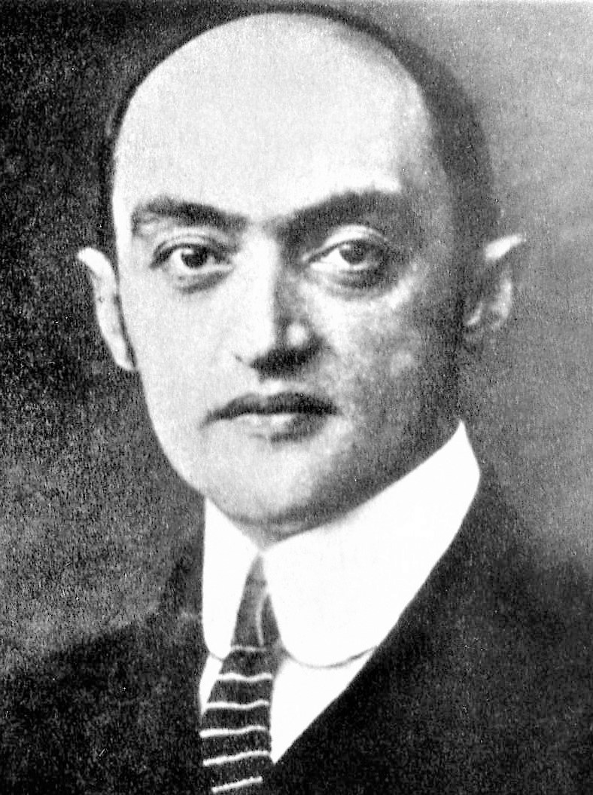
1. Introduction
Joseph Schumpeter
February 8, 1883 – January 8, 1950
Austrian-born political economist
Served as Finance Minister of German-Austria in 1919 to 1921(age of 36)
In 1932, he emigrated to the United States and became a professor at Harvard
in 1939 obtained American citizenship.
Key concept : Creative Destruction (refer to Sectoral Systems of Innovation)
Books
- TED : The Theory of Economic Development (published in 1911)
- CSD : Capitalism, Socialism, and Democracy (published in 1942)
*source : Wikipedia and the article

Slide 5




2. The Role of Finance in the Economics of Innovation 2.1 The Pioneering Work of Schumpeter
[TED] Schumpeter argued that innovation was financed through the creation of credit. Schumpeter believed that credit could be created in a variety of ways but he gave prominence to the role of the commercial bank in generating new purchasing power and making it available to entrepreneurs.
[CSD] Schumpeter claimed that the “perfectly bureaucratized giant industrial unit” had succeeded in rationalizing and routinizing the process of innovation to such an extent that the large-scale enterprise had become “the most powerful engine” of economic progress.
Notes:
There is a changing on his view on recognizing main actor of the Innovation.

Slide 6
2. The Role of Finance in the Economics of Innovation 2.2. The Neglect of Finance in the Contemporary Economics of Innovation
Schumpeter’s assertion of a general historical transformation from an innovation process dominated by new ventures to one driven by large industrial firms has been rejected. Contemporary scholars have emphasized that both of these patterns of innovation coexist .
However, hardly any attention has been devoted to the relationship between innovation and resource allocation even though Schumpeter's analysis of it is as controversial and incomplete as his characterization of innovation
Notes:
There is a changing on his view on recognizing main actor of the Innovation.

Slide 7
3. Innovation and the Economics of Finance 3.1 The Microeconomics of Enterprise Finance
A whole new set of theories of corporate finance emerged that took as their starting assumption the importance of “information asymmetry”
In analyses of the influence of enterprises' activities on their financing, R&D investments attracted particular attention since they were deemed to create acute information asymmetries between corporate managers and financiers. ~ Therefore, R&D-intensive firms should be more inclined than other firms to rely on internal funds to finance their investments.

Slide 8
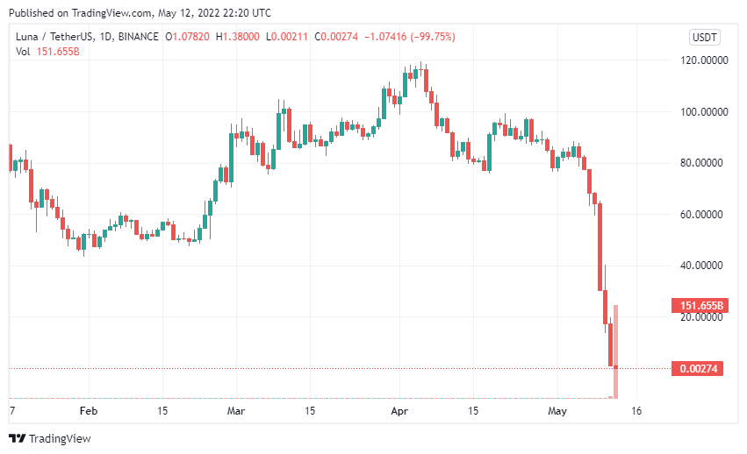

3. Innovation and the Economics of Finance 3.1 The Microeconomics of Enterprise Finance
*source : datadriveninvestor.com

Slide 9
3. Innovation and the Economics of Finance 3.2 Financial Systems and Economic Growth
there is a technological reason why some industries depend more on external finance than others. To the extent that the initial project scale, the gestation period, the cash harvest period, and the requirement for continuing investment differ substantially between industries, this is indeed plausible. (Rajan and Zingales 1998: 563)
Their main hypothesis is that industries that are more dependent on external finance should grow faster in countries with more developed financial markets.
Differences in the growth trajectories of particular industries will in turn be reflected in variations across country in the composition of economic growth

Slide 10
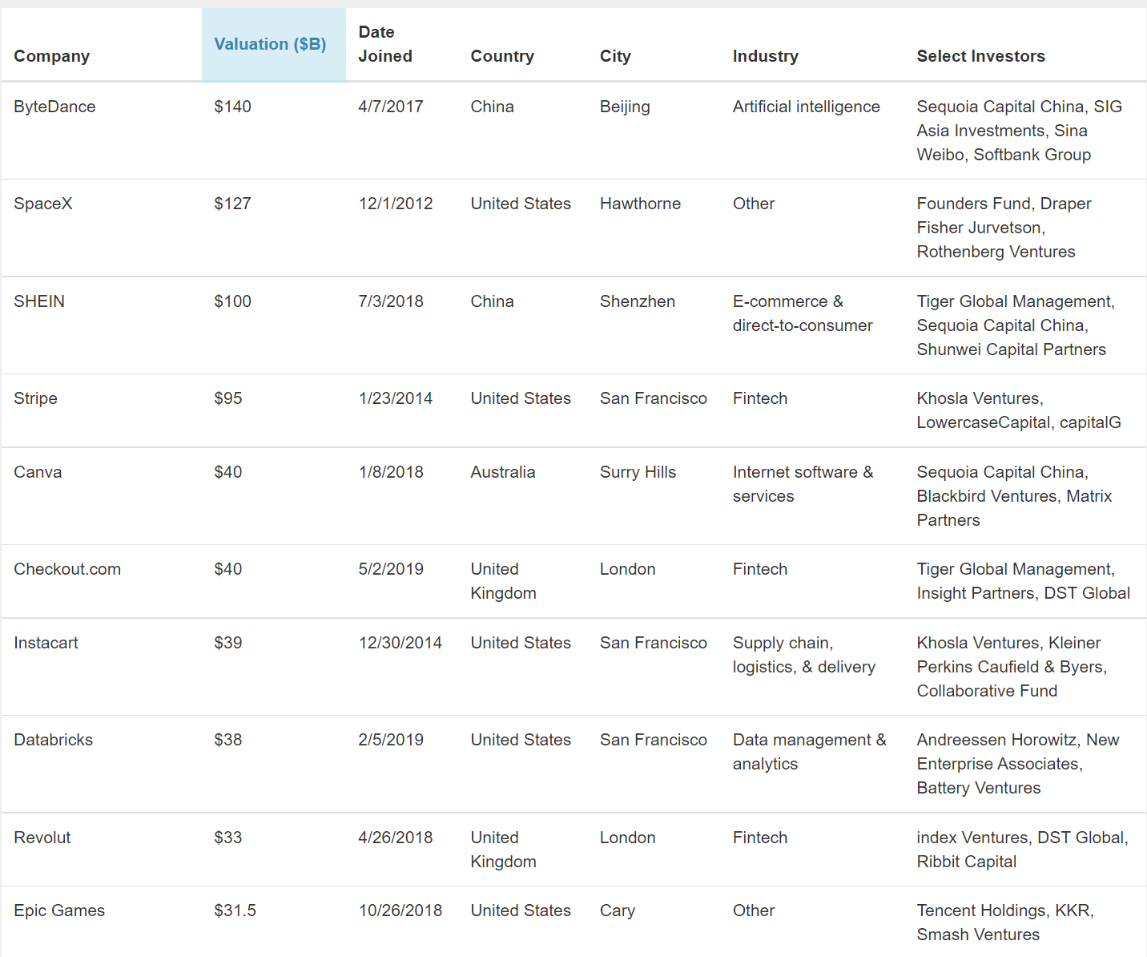
3. Innovation and the Economics of Finance 3.2 Financial Systems and Economic Growth
*source : cbinsights.com

Slide 11
4. A New Agenda for Research on Finance and Innovation 4.1. Finance Theory and the Dynamics of Economic Change
More fundamentally, it is not clear that privileged access to information by some economic actors is the major determinant of the challenges for enterprises in financing such investments. When making innovative investments, a more important challenge than asymmetric information is the fundamental uncertainty that characterizes the relationship between investments and their outcomes.
Economists who take seriously the fundamental uncertainty that surrounds innovative investment have tended to emphasize the importance of subjective judgements, based on perceptions and belief systems, for decision making.

Slide 12
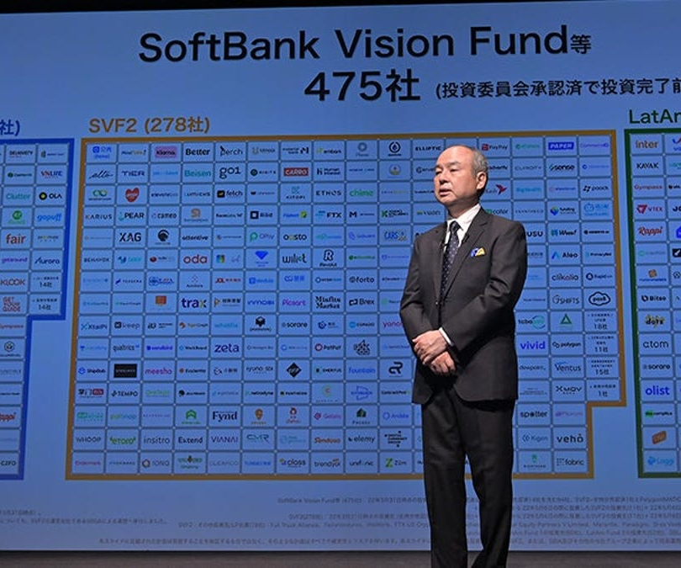
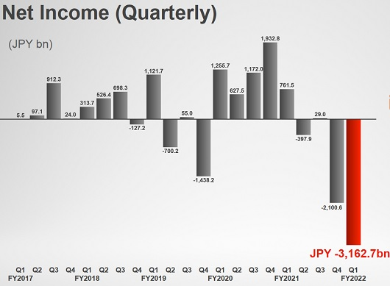
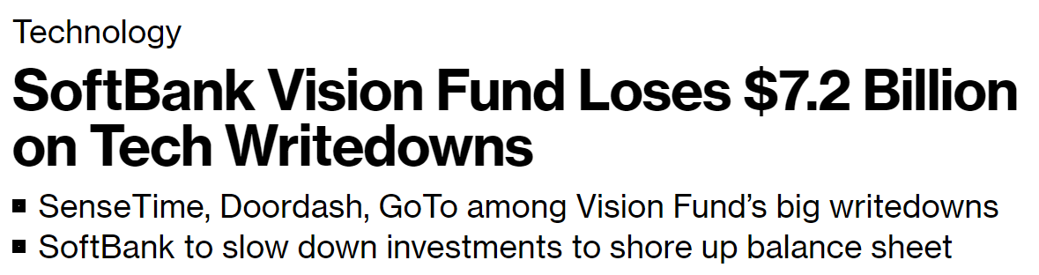
4. A New Agenda for Research on Finance and Innovation 4.1. Finance Theory and the Dynamics of Economic Change
Approx. -$22 bil
*source : Bloomberg, zdnet.com, wolfstreet

Slide 13
4. A New Agenda for Research on Finance and Innovation 4.2. The Possibilities and Problems of Integration between Fields
Perhaps the most important methodological obstacle to cross-fertilization between the fields of innovation and finance is the different priorities that they assign to history in economic analysis.
In recognition of the importance of change over time in the process that they study, economists of innovation often describe themselves as “evolutionary economists”
In contrast, most financial economists neglect the fact that capitalism is an evolutionary process.

Slide 14
5. Conclusion
Although Schumpeter made the study of resource allocation, contemporary economists of innovation have largely neglected the relationship between finance and innovation.
However, there are some assertions on the issue, R&D investment is implemented with the concept of “information asymmetry,” which causes a tendency to rely on internal funds.
A more critical challenge than asymmetric information is the fundamental uncertainty between investments and their outcome.

Slide 15
Discussion
From the article, we understood that allocating finance acts main role, not the quantity of the R&D financial quantity. However, because of the uncertainty of the capital, it is hard to anticipate the outcome of the investment. If so, I think, as a moderator or people who are responsible for R&D, not who are inside of the venture company, at least secure the amount of investment and create conditions to provide to venture companies.
Because there is a limitation in government and public financial fund's administrative hands, we need structural organization to handle the allocation problem.

